Slide 1
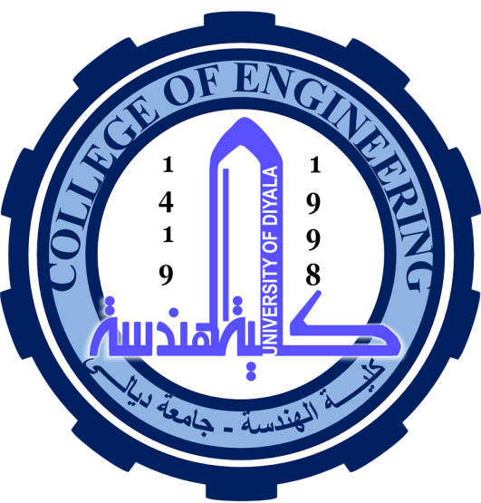
University of Diyala
College of Engineering
Department of Electronics Engineering
Course Number: U103
Course Name: Computer Science
Lecture (3)
Asst. Lect. Wurod Qasim Mohamed

Slide 2
Computer Hardware
Hardware represents the physical and tangible components of a computer, i.e. the components that can be seen and touched.
Examples of Hardware are the following −
Input devices − keyboard, mouse, etc.
Output devices − printer, monitor, etc.
Secondary storage devices − Hard disk, CD, DVD, etc.
Internal components − CPU, motherboard, RAM, etc.

Slide 3
Motherboard
The motherboard serves as a single platform to connect all of the parts of a computer together. It connects the CPU, memory, hard drives, optical drives, video card, sound card, and other ports and expansion cards directly or via cables. It can be considered as the backbone of a computer.
Features of Motherboard
A motherboard comes with following features −
Motherboard varies greatly in supporting various types of components.
Motherboard supports a single type of CPU and few types of memories.
Video cards, hard disks, sound cards have to be compatible with the motherboard to function properly.
Motherboards, cases, and power supplies must be compatible to work properly together.

Slide 4
Central Processing Unit (CPU)
Central Processing Unit (CPU) consists of the following features −
CPU is considered as the brain of the computer.
CPU performs all types of data processing operations.
It stores data, intermediate results, and instructions (program).
It controls the operation of all parts of the computer.

Slide 5
CPU itself has following three components.
Memory or Storage Unit
Control Unit
ALU(Arithmetic Logic Unit)

Slide 6
Practical Laboratory Part

